Slide 1
Destined Duo
Ruchika Singh, Kyra Jeckering,
Brianna Lopez, Aneesh Kadali

Slide 2
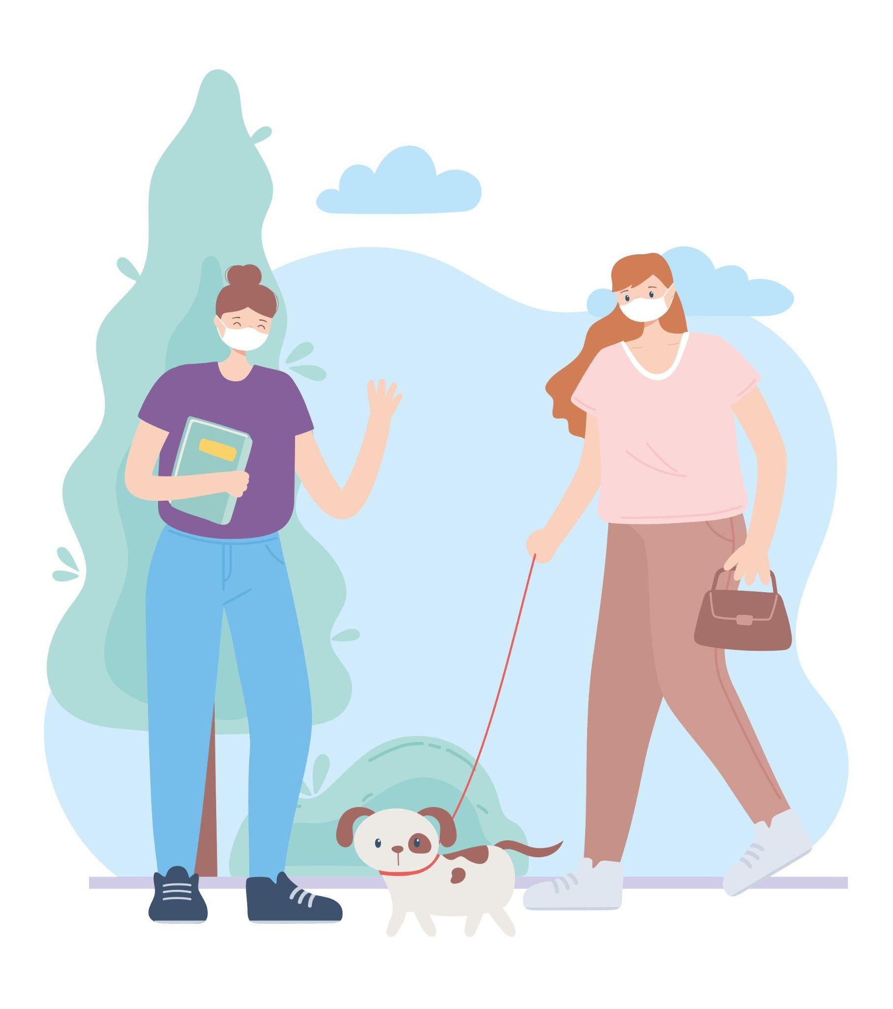
HELLO!
We are team...
Brianna
Aneesh
Ruchika
Kyra

Slide 3
What We Did

Slide 4
Homepage
About Us Section
Slideshow
Target Audience
Homepage will be a universally accessible page

Slide 5
Sign up Page
Created multi-step form
Form repeater to enter multiple interests
Added css to page
Currently links to homepage

Slide 6
Login Page
Dynamic resizing of form
Using RPI emails for CAS
Directly links to sign-up page
CSS matching

Slide 7
Profile Page
Displays your information that you wish to show:
Profile Picture and Name
About me
Contact Info
Interests
Multiple different CSS Animations
Links to all of the pages

Slide 8
Explore Page
Slideshow
Search for new friends
Dynamically created profile cards using hardcoded data about users

Slide 9
The Next Steps

Slide 10
Sign up Page
Add form validation
On submit save data to database
Add any additional inputs
Redirect page to login on submit

Slide 11
Login Page
Add form validation
Provide form feedback

Slide 12
Profile Page
Have an Edit Profile button
Takes you to a form to change content on Profile page
Form validation
Saving information to a database to be specific to each user

Slide 13
Explore Page
Database implementation
Data should not be hardcoded
Linking to user-specific profiles from profile cards

Slide 14
Demo

